Slide 1

CAP615 PROGRAMMING IN JAVA
Lecture #0
The kick start session

Slide 2
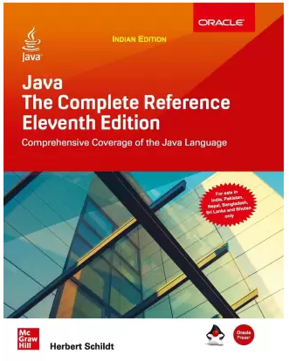
Course details
LTP – 3 0 0 [Three lectures/week]
Text Book
JAVA: THE COMPLETE REFERENCE by HERBERT SCHILDT, Tata McGraw Hill, India
Reference Books:
1.INTRO TO JAVA PROGRAMMING
(COMPREHENSIVE VERSION) by Y. DANIEL LIANG,
Pearson Education India
2. PROGRAMMING WITH JAVA by
E BALAGURUSAMY, Tata McGraw Hill, India

Slide 3
Course Assessment Model
Marks break up
Attendance 5
Continuous Assessment(2 out of 3) 25
MTT 20
ETT 50
Total 100

Slide 4

The hitch…
The three BURNING questions in mind…
Why are we learning JAVA language?
What would we do with it?
What will be the course outcome?

Slide 5
Course Outcomes:
define the structure and model of the Java programming language
understand the accessibility of fields and methods of an object through String and StringBuilder classes
apply multithreading concepts to implement inter-process communication
analyze object serialization with file handling and exception handling to overcome runtime errors
develop applications using database connectivity to perform CRUD operations

Slide 6
Learnings for you…?
Desktop GUI Applications
Mobile Applications
Enterprise Applications
Scientific Applications
Web-based Applications
Embedded Systems
Big Data Technologies
Distributed Applications
Cloud-based Applications
Web servers and Application servers
Software Tools
Gaming Applications

Slide 7
Companies like:
Naukri,
Jabong,
Google,
Myntra,
Flipkart,
Trivago,
ibibo
TripAdvisor
Spotify,
Uber,
TCS,
Infosys,
HCL,
Wipro,
Pinterest,
eBay,
etc use Java.

Slide 8
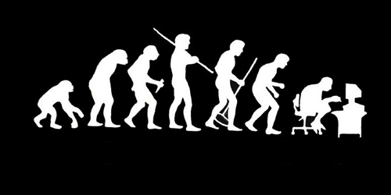
Let us re-invent ourselves
To begin with basics…
Let us go to basics.
Let us begin from toddling to learn to walk
Get ready to be childish….

Slide 9
Daily routine
Let us look around our daily routine…
Let us see where all we do programming everyday
Simple things we do to start the day

Slide 10
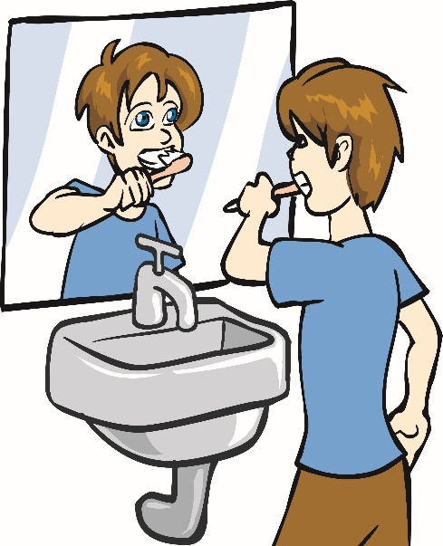
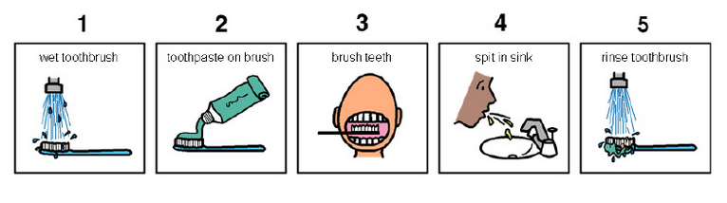
So there is ONE program you know which is there in you…

Slide 11
Daily routine
Start
There is a set procedure
Each step is defined
The occurrence is ordered
Jump is NOT permitted
A step cannot be skipped
Pick Brush
Rinse Brush
Apply Paste
Brush
Rinse Mouth
Rinse Brush
Stop

Slide 12


Daily routine
Let us explore more as the day goes by…
Going for a morning 0900 AM Class
Going for a movie at 0900 AM
It is all about WHICH program is loaded WHEN

Slide 13


Daily routine
The flow changes
Start
Go!!!
Where
To
Go?
Class
Movie
Stop
Stop

Slide 14

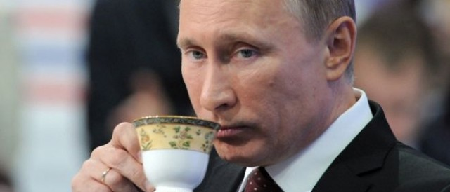




Daily routine
Yet another example but more complex
Vision
Sensor
Sipping TEA
Smell
Sensor
Radiation
Sensor
If all sensors
SIP
If even one is
Touch
Sensor
WAIT!!!

Slide 15




So what does this mean?
Take ANY activity of the day…
It will have a set procedure
It has to be done in a designated way
If not done the specified way will yield wrong results.
Success in doing it depends on how closer one is to the prescribed method.
This clearly shows that everything has a
Logic

Slide 16

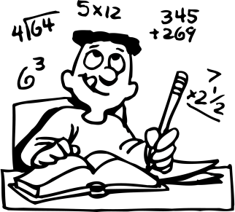
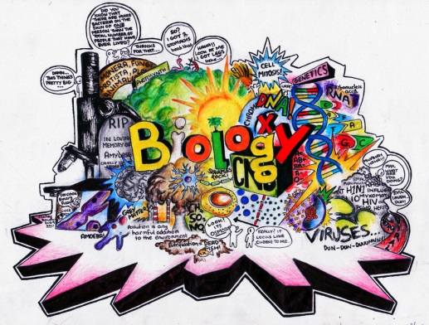





Logic, logic and logic
Logic

Slide 17
What next?
If there is logic in anything and everything
There has to be ways to represent logic
There has to be modes to modify and re-represent logic.
There should be methodology to implement and re-design logic.
And for all this…

Slide 18


What next?
There has to be logic machine to assimilate, understand, solve, store, retrieve and represent logic
There has to be a LANGUAGE to communicate with the logic machine
Otherwise….

Slide 19



Diving deeper…
How do I get A+ grade in CAP615?

Slide 20


Diving deeper…
How do I get A+ grade in CAP615?
If marks are greater than or equal to 85.
A program written in Java language with LOGIC

Slide 21
The course contents
Introduction to Java
Collection Framework
Multithreading
Swings and Layouts
Managing data using JDBC
Network Programming

Slide 22
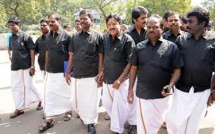


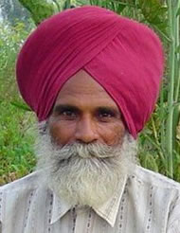

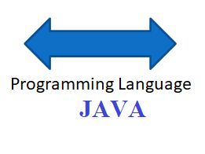
What do we need to know?
Unit 1
Tamil
Punjabi
Need of Language :: Introduction to Java

Slide 23
What do we need to know?
Unit 1
Principles of OOP's and Java Basics
How to do calculations
Area = Length * Breadth
Area = 12 * 5
Area = 10 * 4
Area = 7.6 * 3.7
3.7
4
7.6
5
10
12
Performing Calculations in JAVA:: Variables and operators

Slide 24

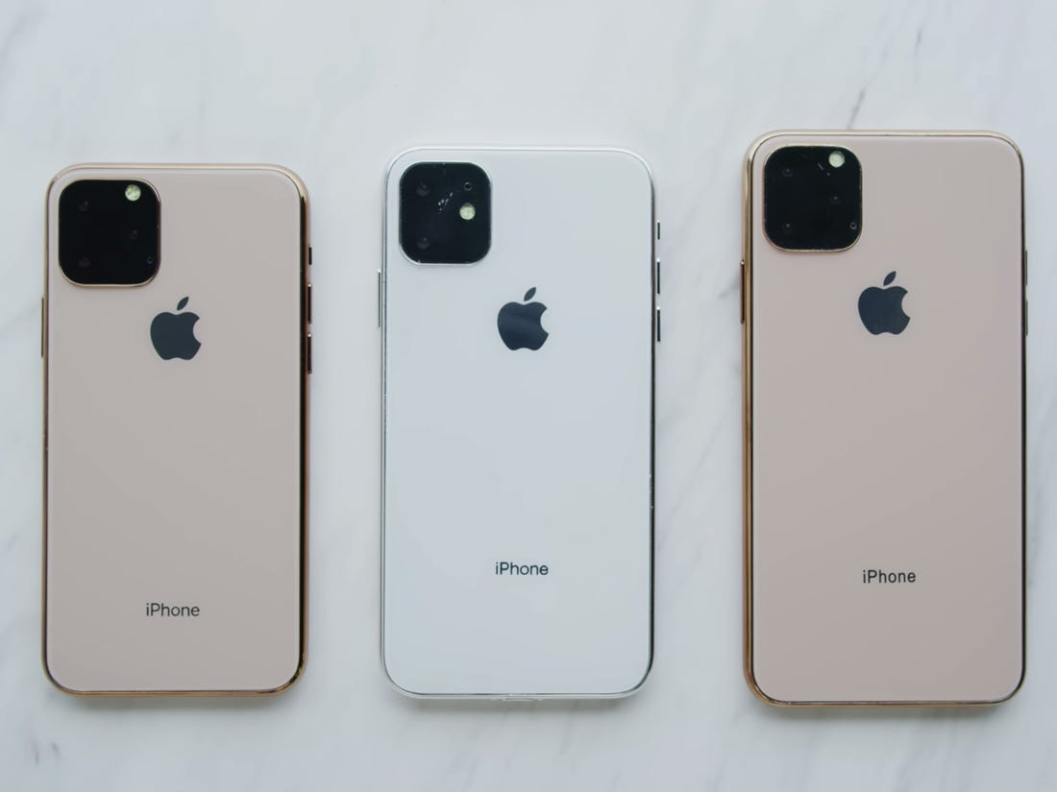
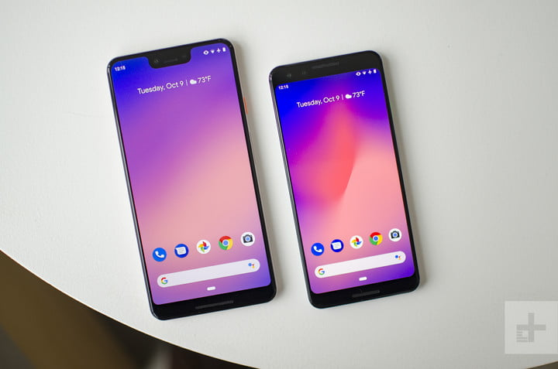
What do we need to know?
Unit 1
Classes and Objects
Mobile
Symbian
(Keypad
Phone)
Android
phone
i-phone

Slide 25



What do we need to know?
Unit 1
Inheritance: reusability
father
mother
child

Slide 26
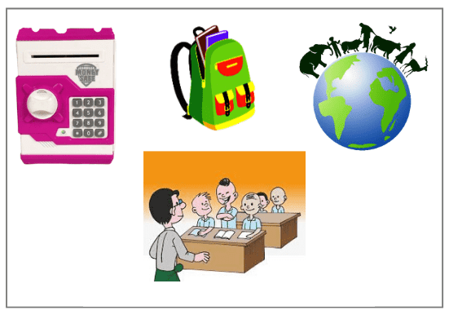
What do we need to know?
Unit 2
Collection Framework

Slide 27
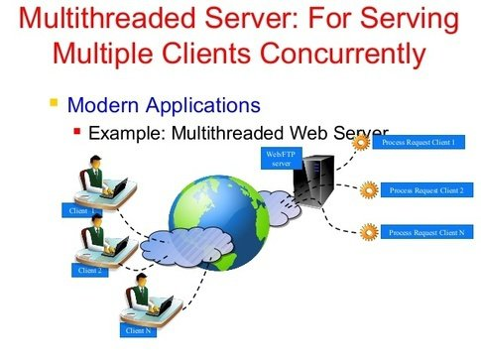
What do we need to know?
Unit 3
Multithreading

Slide 28
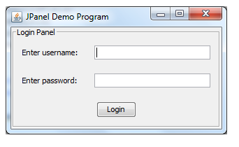
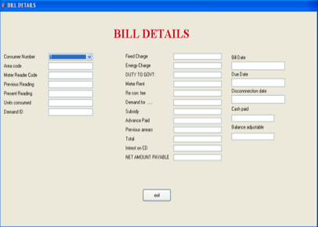
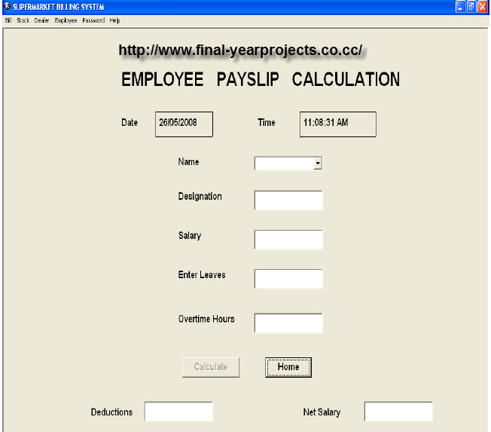
What do we need to know?
Unit 4
Swings and Layouts

Slide 29
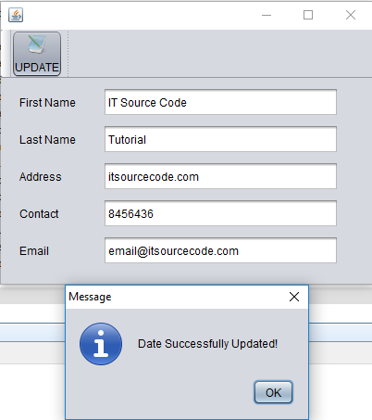
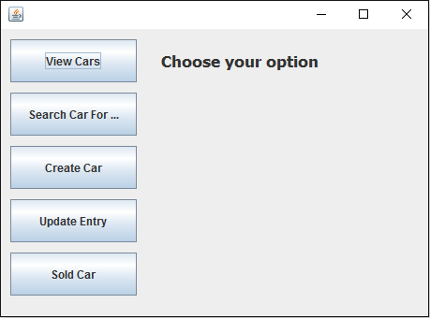
What do we need to know?
Unit 5
Managing data using JDBC

Slide 30
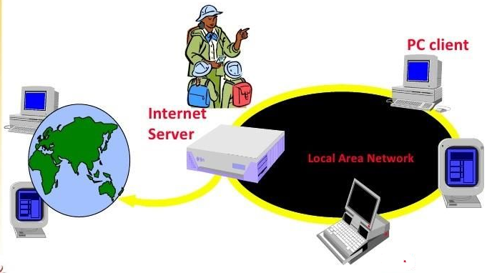

What do we need to know?
Unit 6
Network Programming

Slide 31
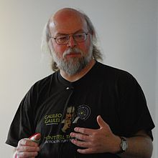
Recognize?
A. Dennis Ritchie
B. Bjarne Stroustrup
C. James Gosling
D. None

Slide 32
Which is OOPs feature?
Encapsulation
Polymorphism
Inheritance
Above All

Slide 33
Acknowledgements
NPTEL(National Programme on Technology Enhanced Learning)
Simplilearn
Coursera
edureka
Common Sense

Slide 34

Next :Introduction to JAVA

